Slide 1
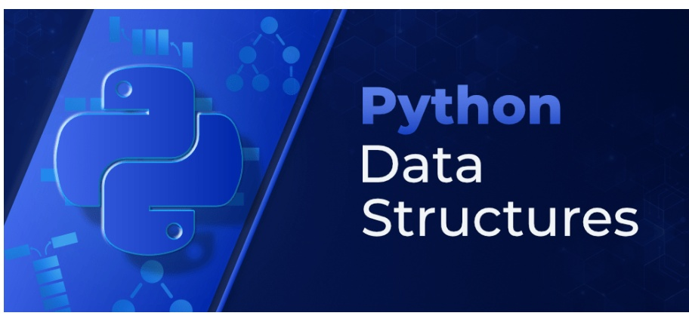
PYTHON ADVANCE
INTRODUCTION TO ALGORITHMS &
DATA STRUCTURES

Slide 2
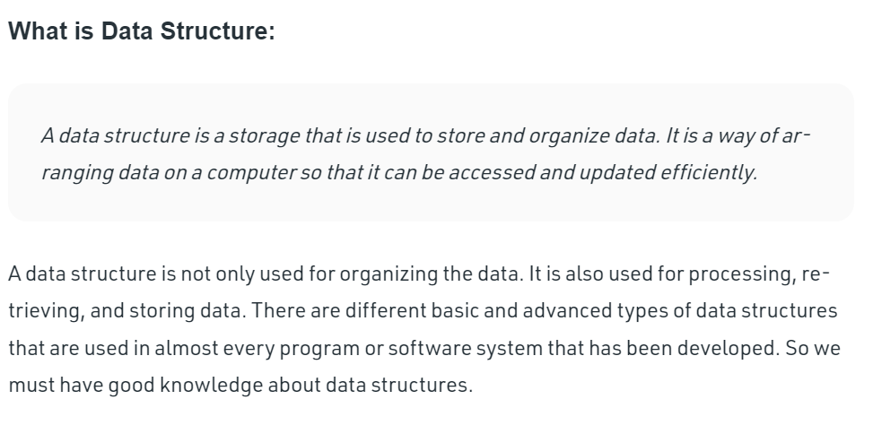
INTRODUCTION

Slide 3
Data structures in Python
Organizing, managing and storing data is important as it enables easier access and efficient modifications.
Data Structures allows you to organize your data in such a way that enables you to store collections of data, relate them and perform operations on them accordingly.
Built-in Data Structures
As the name suggests, these Data Structures are built-in with Python which makes programming easier and helps programmers use them to obtain solutions faster.
User-Defined Data Structures
Data structures that aren’t supported by python but can be programmed to reflect the same functionality using concepts supported by python are user-defined data structures.

Slide 4
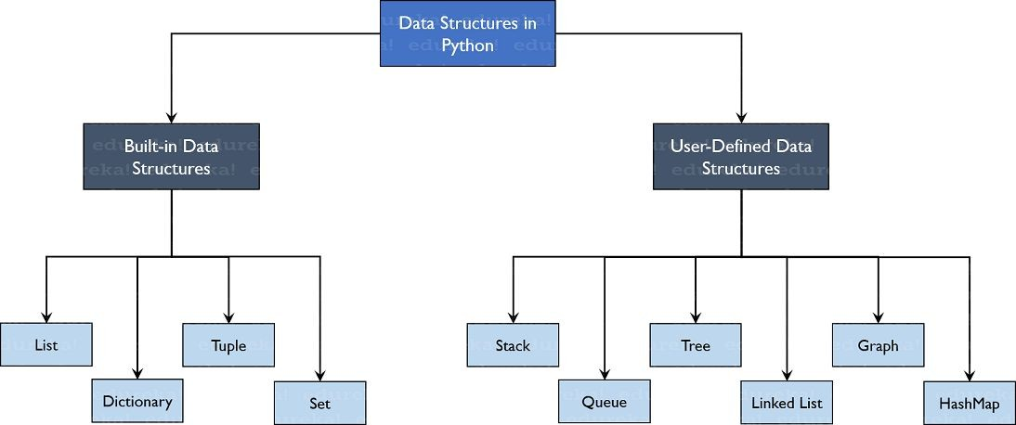

Slide 5
list1 = ['physics', 'chemistry', 1997, 2000]
list2 = [1, 2, 3, 4, 5 ]
list3 = ["a", "b", "c", "d"]
dict = {'Name': 'Zara', 'Age': 7, 'Class': 'First'}
tup1 = ('physics', 'chemistry', 1997, 2000);
tup2 = (1, 2, 3, 4, 5 );
tup3 = "a", "b", "c", "d";
Days=set(["Mon","Tue","Wed","Thu","Fri","Sat","Sun"])
Months={"Jan","Feb","Mar"}

Slide 6
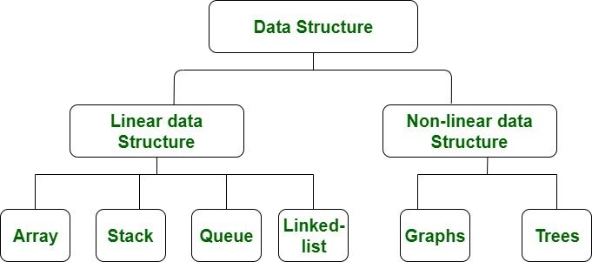

Slide 7
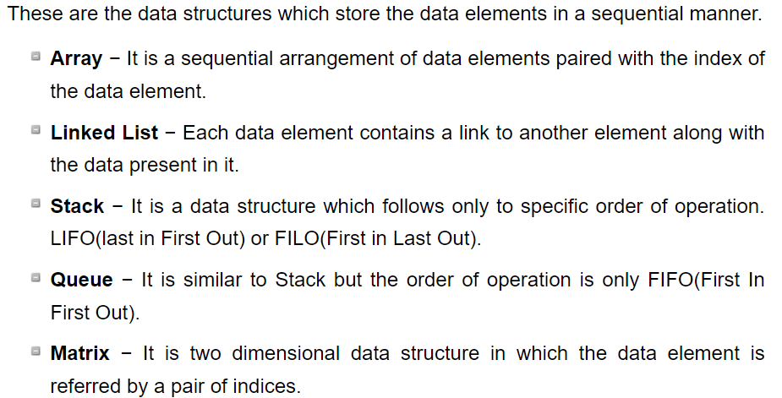
Linear Data Structures

Slide 8
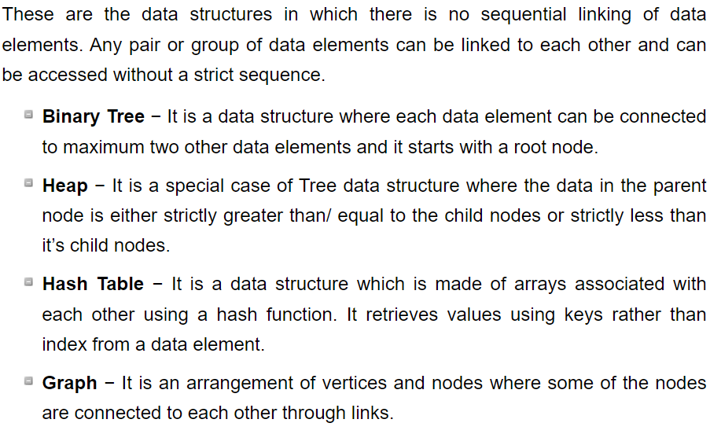
Non-Linear Data Structures

Slide 9
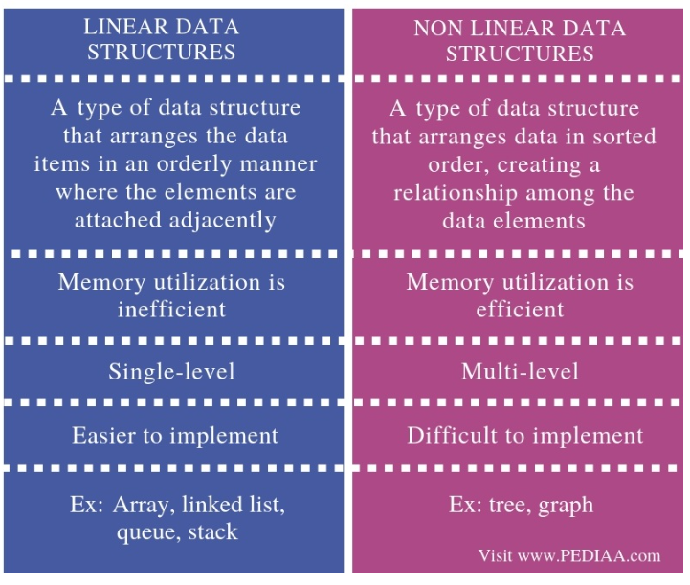

Slide 10
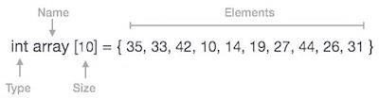
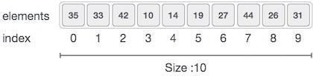
Python - Arrays
Array is a container which can hold a fix number of items and these items should be of the same type. Most of the data structures make use of arrays to implement their algorithms. Following are the important terms to understand the concept of Array are as follows −
Element − Each item stored in an array is called an element.
Index − Each location of an element in an array has a numerical index, which is used to identify the element.
Index starts with 0.
Array length is 10, which means it can store 10 elements.
Each element can be accessed via its index

Slide 11
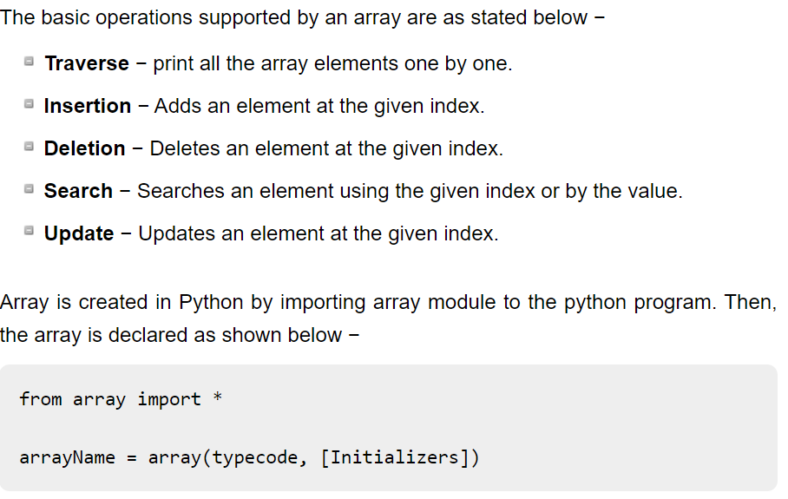
Basic Operations

Slide 12
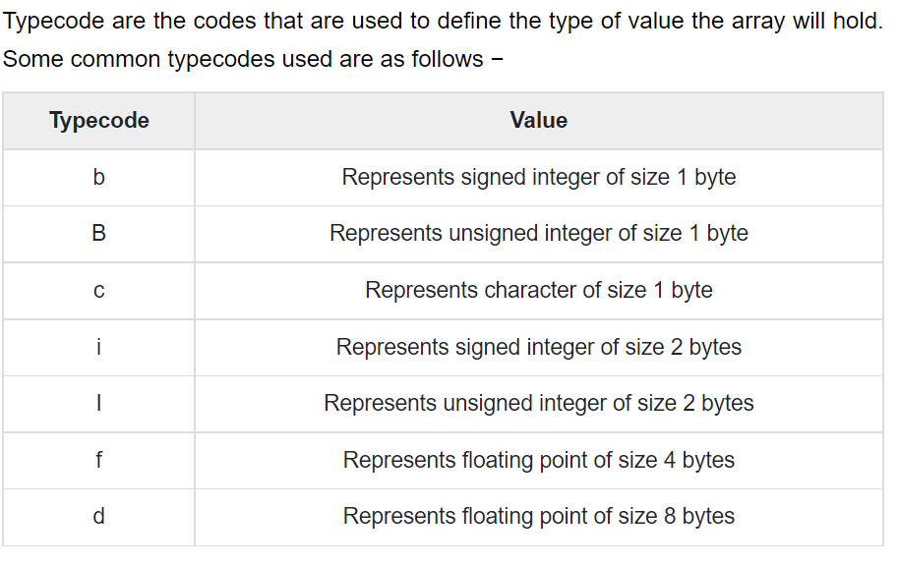
Array creation

Slide 13
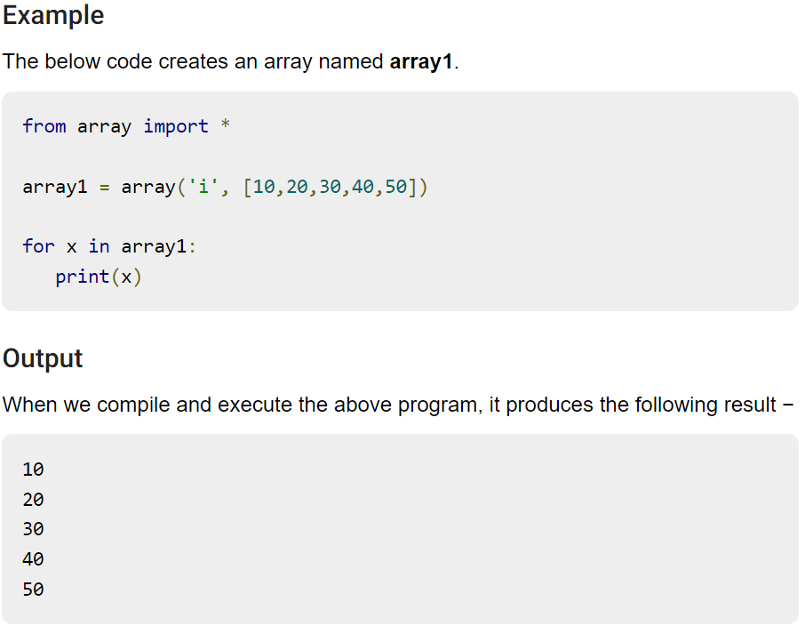
Sample program

Slide 14
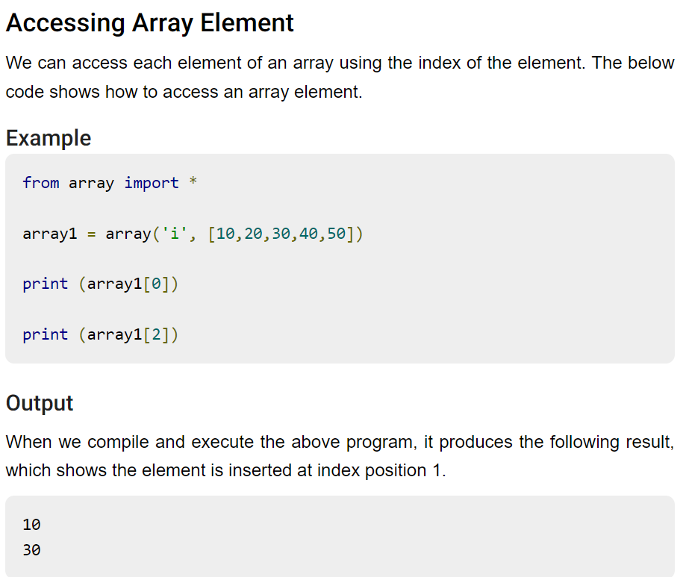

Slide 15
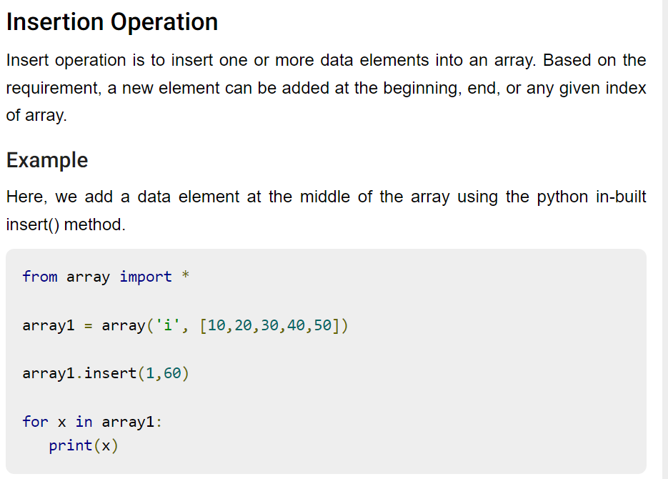

Slide 16
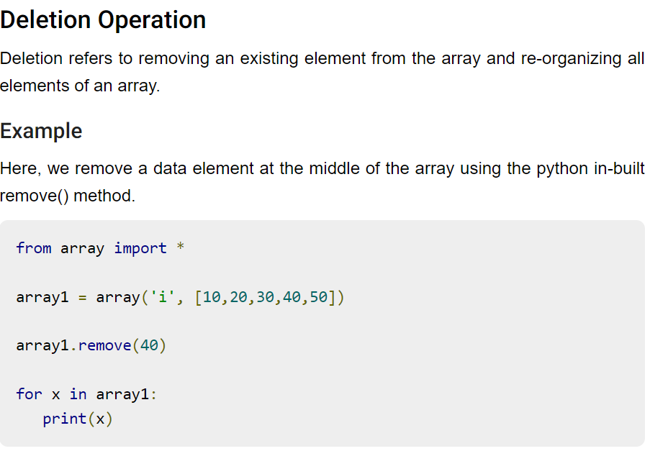

Slide 17
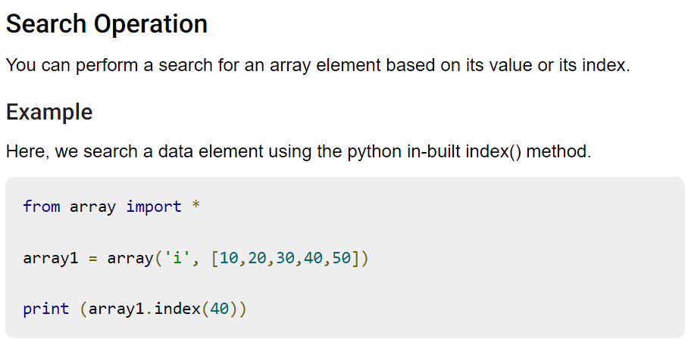

Slide 18
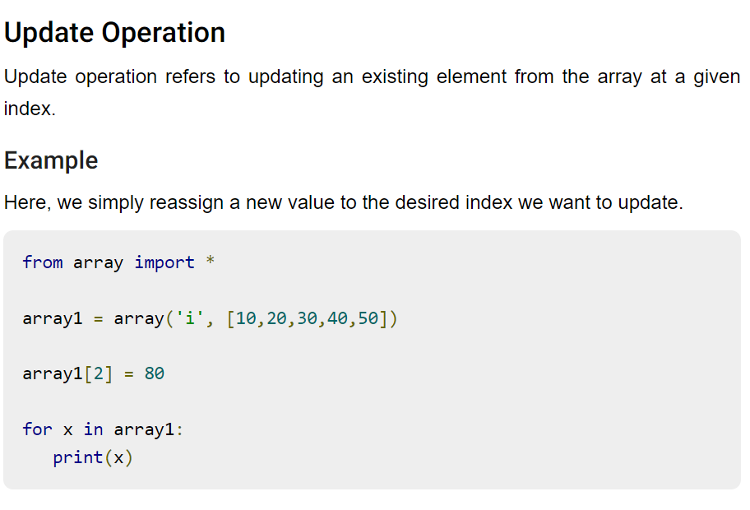

Slide 19
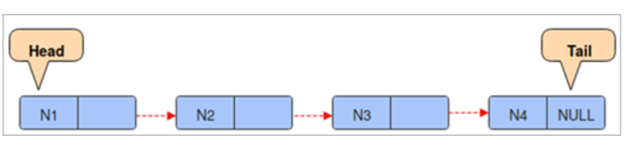
Linked List
A linked list is a sequence of data elements, which are connected together via links. Each data element contains a connection to another data element in form of a pointer.
Python does not have linked lists in its standard library
Representation:
A linked list is represented by a pointer to the first node of the linked list. The first node is called the head. If the linked list is empty, then the value of the head is NULL.
Each node in a list consists of at least two parts:
data
Pointer (Or Reference) to the next node

Slide 20
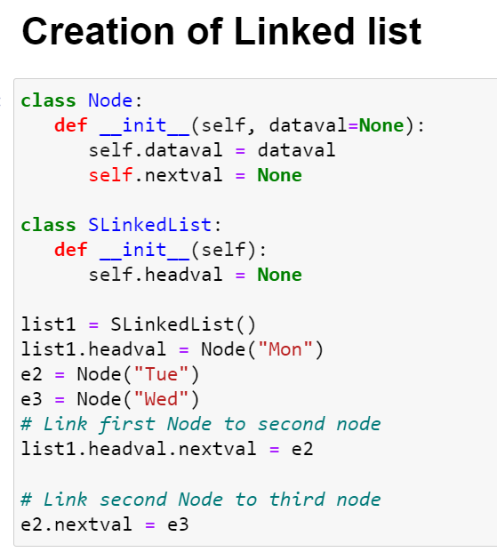

Slide 21
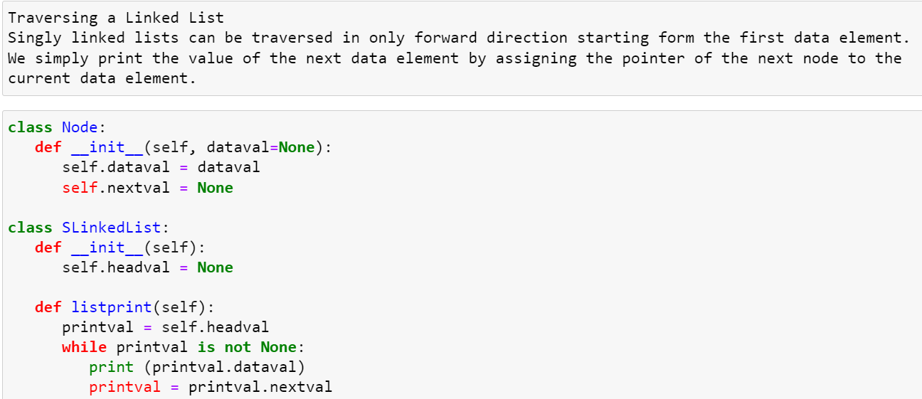

Slide 22
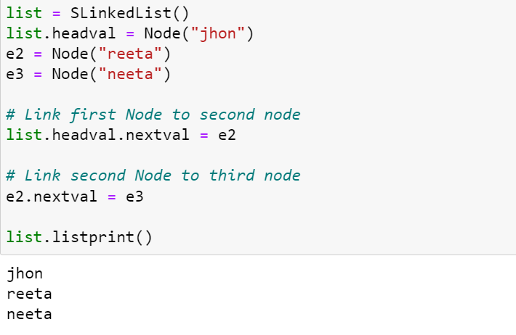

Slide 23
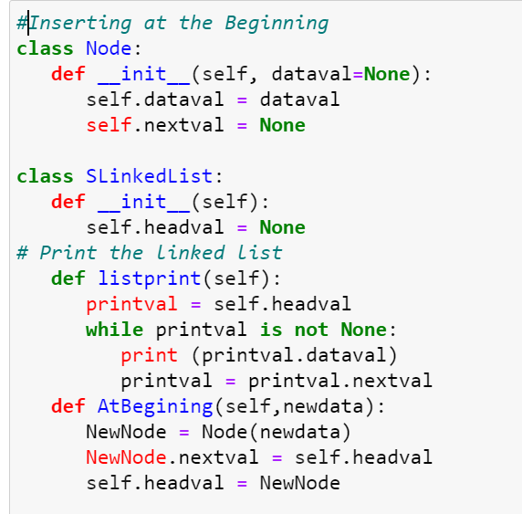

Slide 24
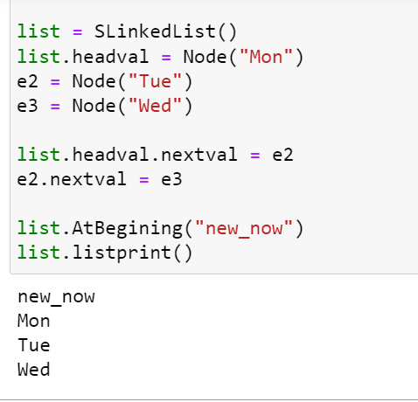

Slide 25
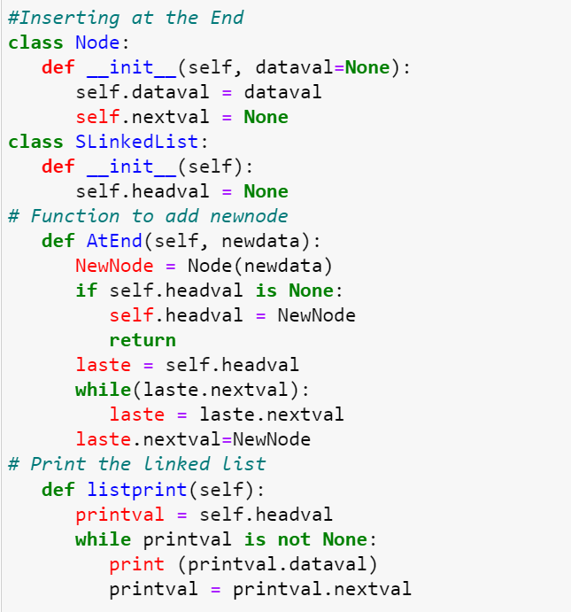

Slide 26
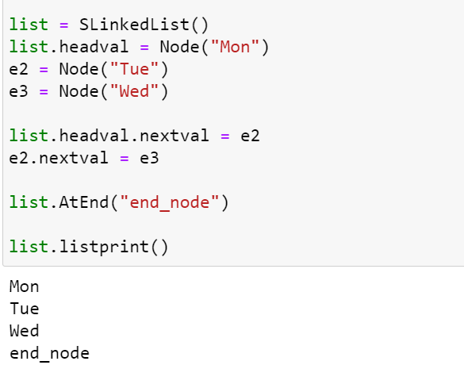

Slide 27
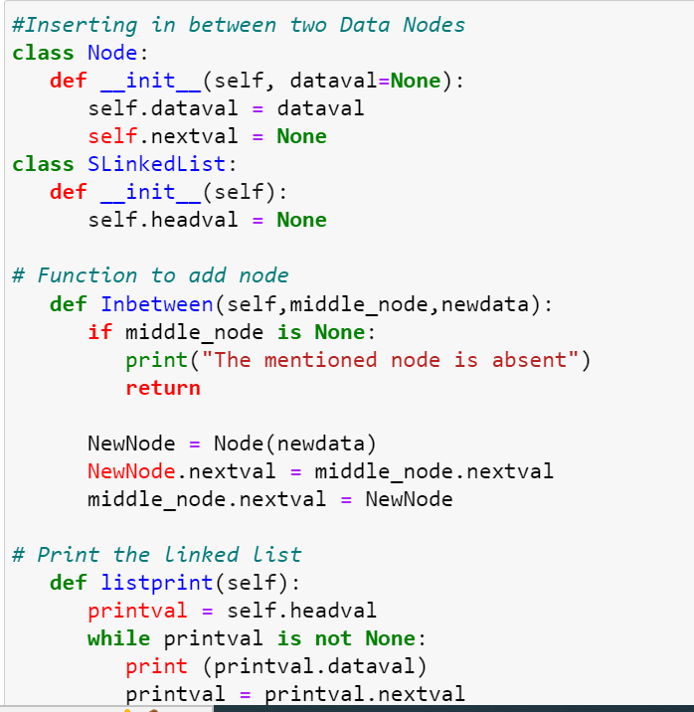

Slide 28
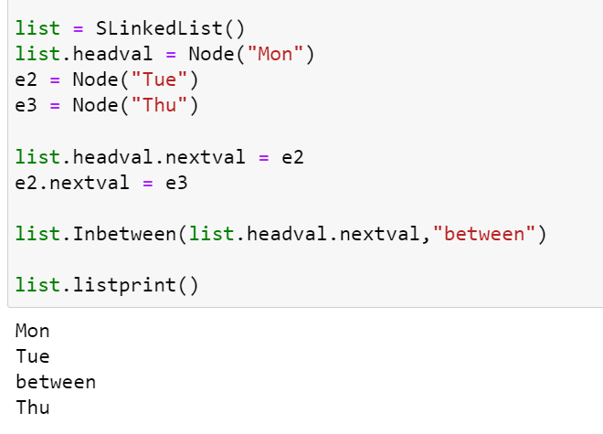

Slide 29
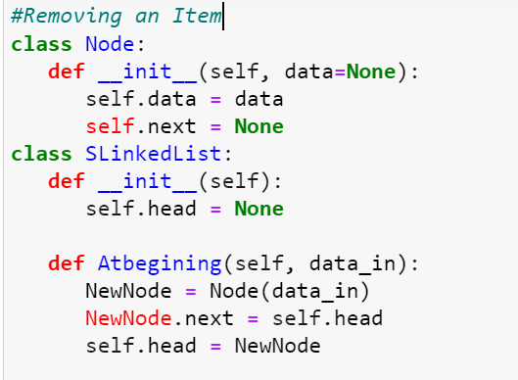

Slide 30
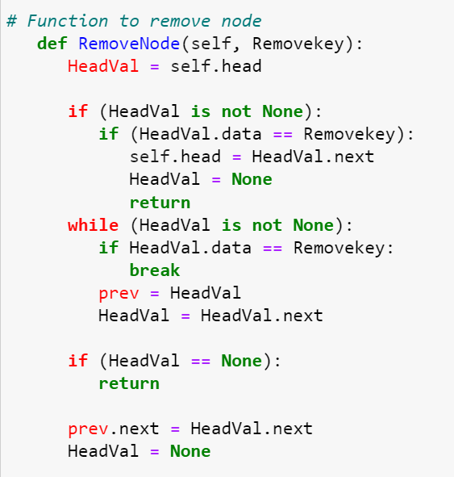

Slide 31
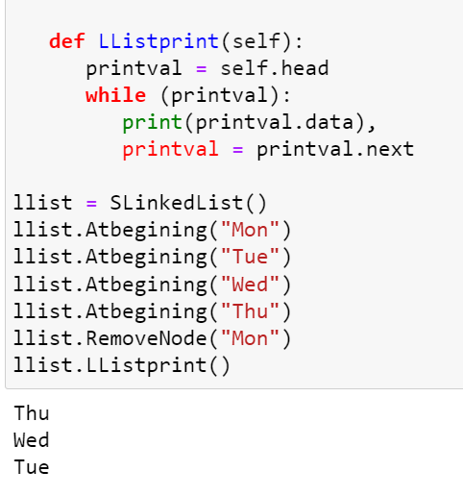

Slide 32
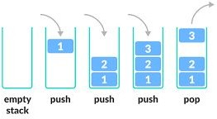
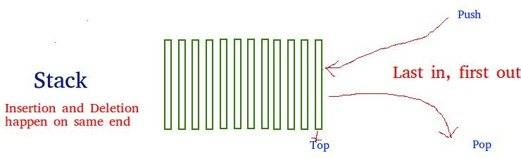
Python - Stack
In the english dictionary the word stack means arranging objects on over another. It is the same way memory is allocated in this data structure.
It stores the data elements in a similar fashion as a bunch of plates are stored one above another in the kitchen.
So stack data structure allows operations at one end which can be called top of the stack.We can add elements or remove elements only form this end of the stack.
In a stack the element inserted last in sequence will come out first as we can remove only from the top of the stack.
Such feature is known as Last in First Out(LIFO) feature. The operations of adding and removing the elements is known as PUSH and POP.
In the following program we implement it as add and and remove functions. We declare an empty list and use the append() and pop() methods to add and remove the data elements.

Slide 33
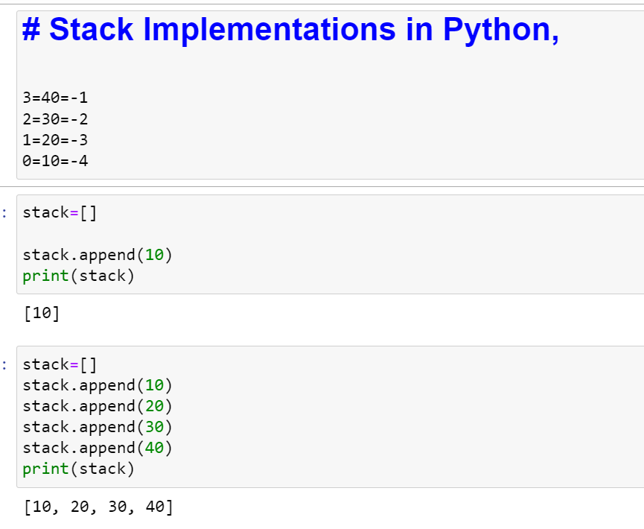

Slide 34
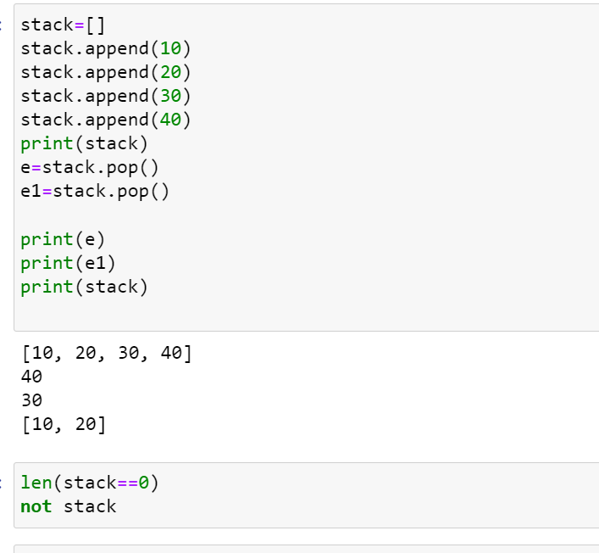

Slide 35
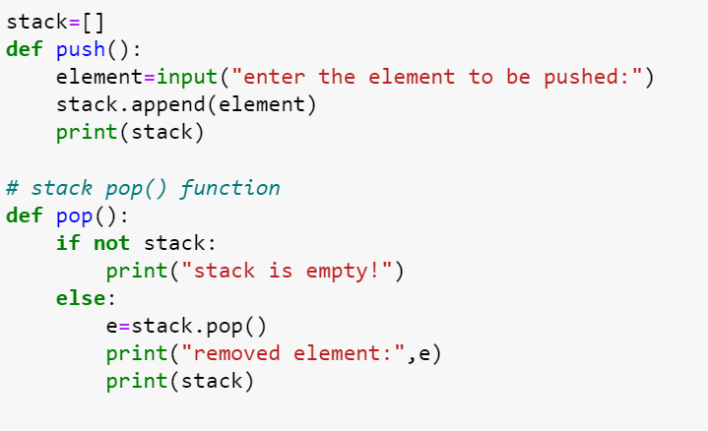

Slide 36
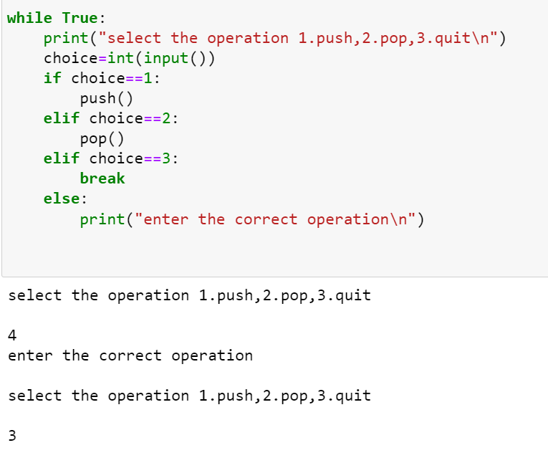

Slide 37
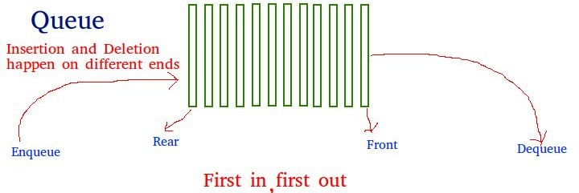
Python - Queue
We are familiar with queue in our day to day life as we wait for a service. The queue data structure also means the same where the data elements are arranged in a queue.
The uniqueness of queue lies in the way items are added and removed. The items are allowed at on end but removed from the other end. So it is a First-in-First out method.
A queue can be implemented using python list where we can use the insert() and pop() methods to add and remove elements.

Slide 38
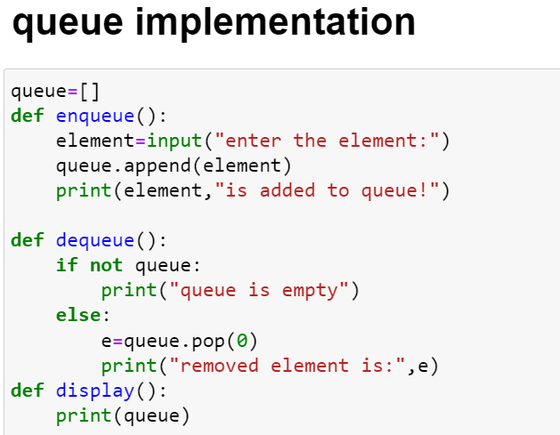

Slide 39
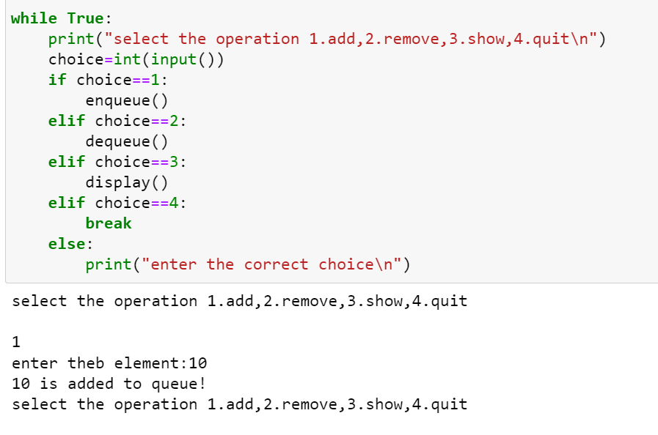

Slide 40
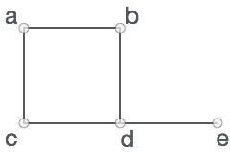
Python - Graphs
A Graph is a non-linear data structure consisting of nodes and edges. The nodes are sometimes also referred to as vertices and the edges are lines or arcs that connect any two nodes in the graph.
Following are the basic operations we perform on graphs.
Display graph vertices
Display graph edges
Add a vertex
Add an edge
Creating a graph
V = {a, b, c, d, e}
E = {ab, ac, bd, cd, de}

Slide 41
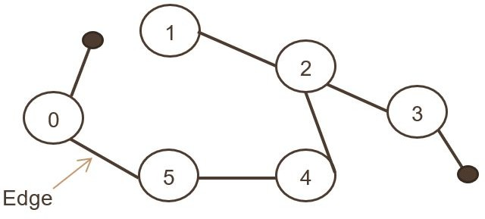
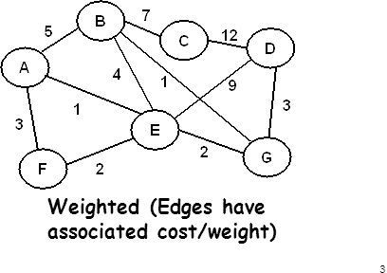
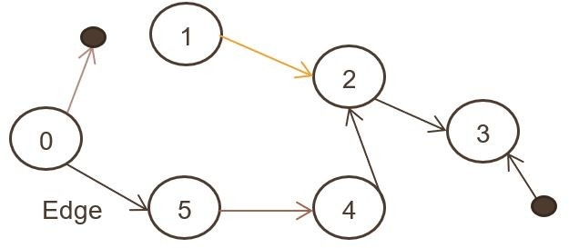
Types of graph
1. Weighted Graph
2. Unweighted Graph
3. Undirected Graph
4. Directed Graph

Slide 42
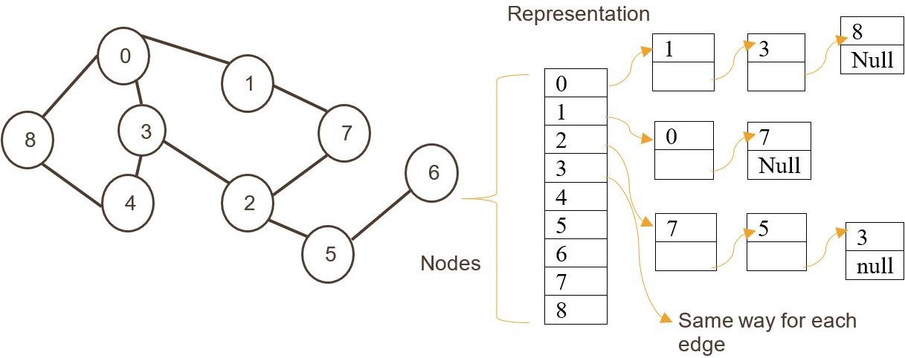
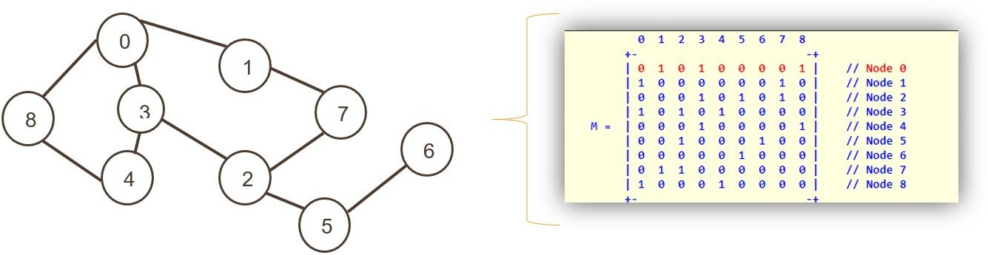
Storing of Graph

Slide 43
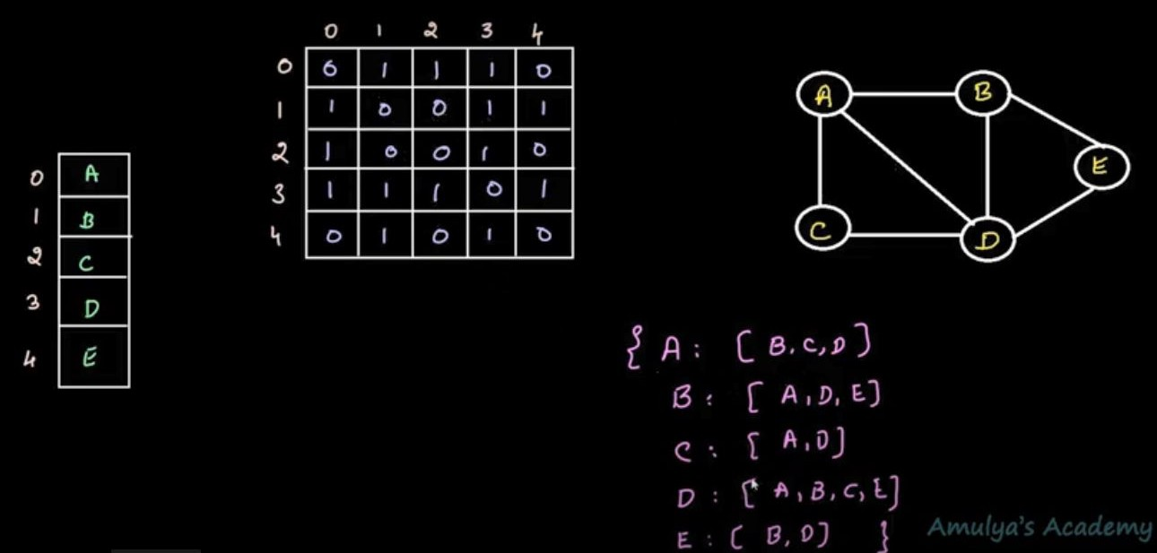
# Create the dictionary with graph elements
g
raph = {
"a" : ["b","c","d"],
"b" : ["a", "d","e"],
"c" : ["a", "d"],
"d" : ["a","b","c","e"],
"e" : ["b","d"]
}
# Print the graph
print(graph)

Slide 44
Adding a vertex

Slide 45
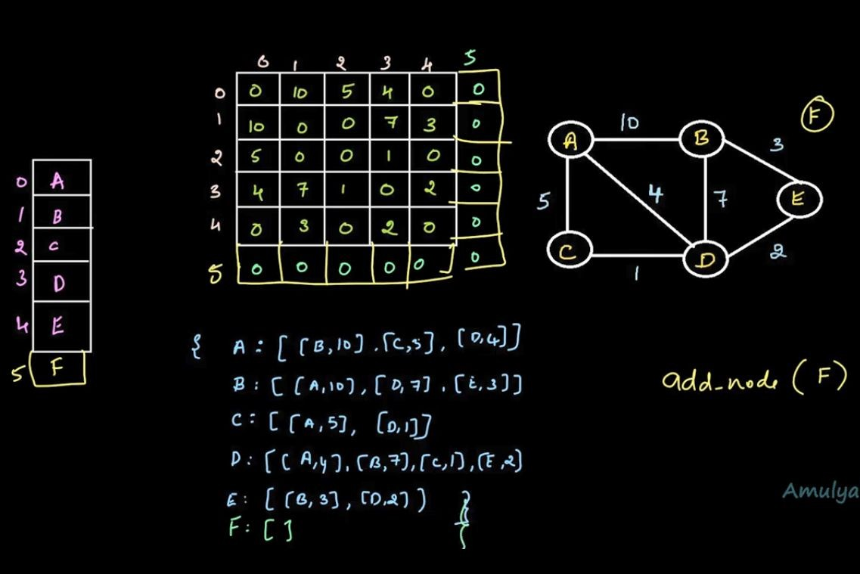

Slide 46
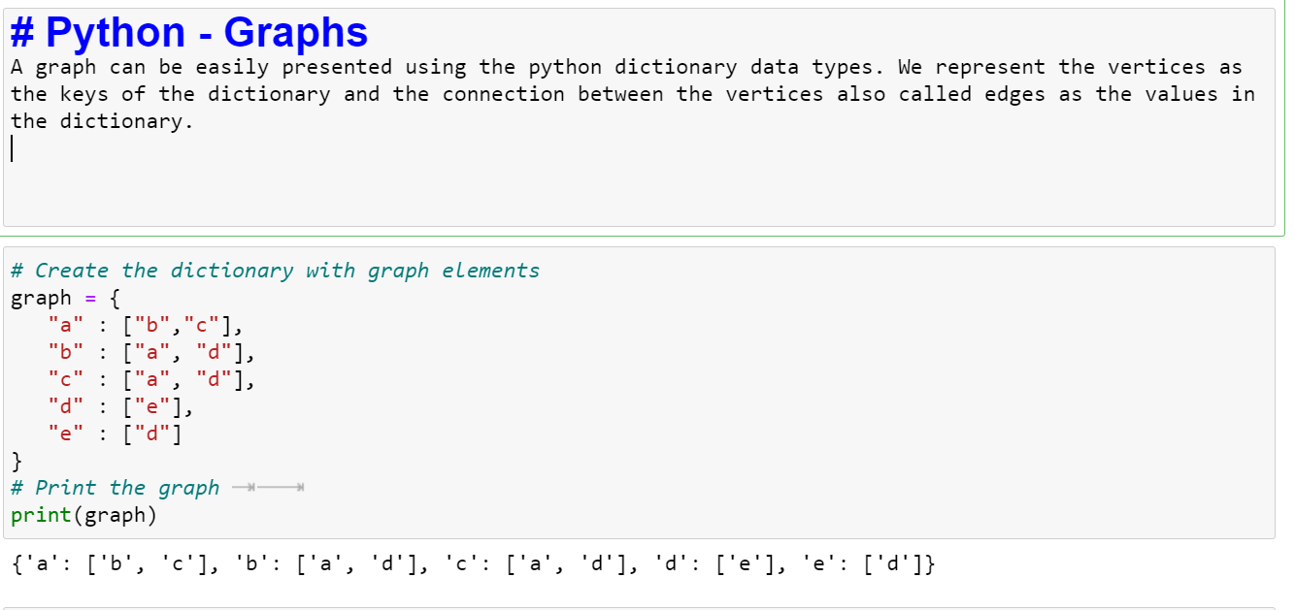

Slide 47
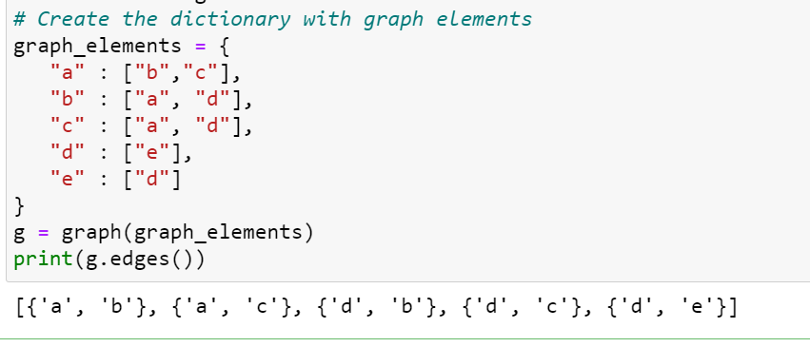

Slide 48
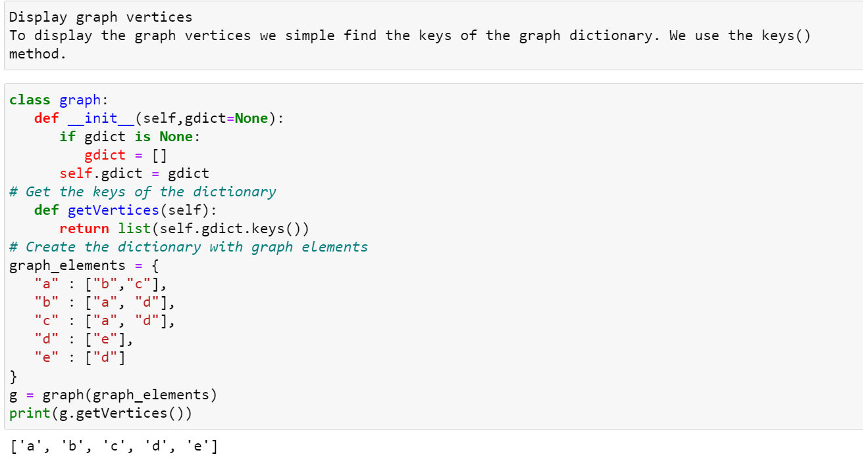

Slide 49


Slide 50


Slide 51


Slide 52


Slide 53


Slide 54


Tree Data Structure
A tree is also one of the data structures that represent hierarchical data. Suppose we want to show the employees and their positions in the hierarchical form then it can be represented as shown below:

Slide 55










Terminology
Root
Edge
Parent
Child
Siblings
Leaf 7.Internal Nodes
Degree
Level
Height
Depth
Path
Sub Tree

Slide 56

Types of Tree
General tree
Binary tree
Binary search tree
AVL tree
Red-black tree

Slide 57




Slide 58


General Tree & Binary Tree
A general tree is a tree data structure where there are no constraints on the hierarchical structure.
Properties
Follow properties of a tree.
A node can have any number of children.
Usage
1. Used to store hierarchical data such as folder structures.
A binary tree is a tree data structure where the following properties can be found.
Properties
Follow properties of a tree.
A node can have at most two child nodes (children).
These two child nodes are known as the left child and right child.
Usage
Used by compilers to build syntax trees.
Used to implement expression parsers and expression solvers.
Used to store router-tables in routers.

Slide 59

Binary search tree
A binary search tree is a more constricted extension of a binary tree.
Properties
Follow properties of a binary tree.
Has a unique property known as the binary-search-tree property. This property states that the value of the left child of a given node should be less than or equal to the parent value and the value of the right child should be greater than or equal to the parent value.
Usage
Used to implement simple sorting algorithms.
Can be used as priority queues.
Used in many search applications where data are constantly entering and leaving.

Slide 60

AVL Tree
An AVL tree is a self-balancing binary search tree. This is the first tree introduced which automatically balances its height.
Properties
Follow properties of binary search trees.
Self-balancing.
Each node stores a value called a balance factor which is the difference in height between its left subtree and right subtree.
All the nodes must have a balance factor of -1, 0 or 1.
Usage
Used in situations where frequent insertions are involved.
Used in Memory management subsystem of the Linux kernel to search memory regions of processes during preemption.
3-2=1
1-2=-1
0-1=-1

Slide 61

AVL Rotations
Left rotation
Right rotation
Left-Right rotation
Right-Left rotation
Left Rotation
If a tree becomes unbalanced, when a node is inserted
into the right subtree of the right subtree,
then we perform a single left rotation −

Slide 62

Right Rotation
AVL tree may become unbalanced, if a node is inserted in the left subtree of the left subtree. The tree then needs a right rotation.

Slide 63





Left-Right Rotation
Double rotations.
A left-right rotation is a combination of left rotation followed by right rotation.

Slide 64




Right-Left Rotation
The second type of double rotation is Right-Left Rotation. It is a combination of right rotation followed by left rotation.

Slide 65


AVL Tree

Slide 66
Arrange the elements based on AVL tree:35,50,40,25,30,60,78,20,28

Slide 67
Red-black tree
A red-black tree is a self-balancing binary search tree, where each node has a colour; red or black. The colours of the nodes are used to make sure that the tree remains approximately balanced during insertions and deletions.
Properties
Follow properties of binary search trees.
Self-balancing.
Each node is either red or black.
The root is black (sometimes omitted).
All leaves (denoted as NIL) are black.
If a node is red, then both its children are black.
Every path from a given node to any of its leaf nodes must go through the same number of black nodes.
Usage
As a base for data structures used in computational geometry.
Used in the Completely Fair Scheduler used in current Linux kernels.
Used in the epoll system call implementation of Linux kernel.

Slide 68


Slide 69


Slide 70

Tree Traversal Algorithms
INORDER-Left→Root→right 3,5,7,10,12,21,25,30,100
POSTORDER-Left→Right→Root 3,7,5,12,10,25,100,30,21
PRE ORDER-Root→left→Right
21,10,5,3,7,12,30,25,100

Slide 71


Slide 72


Slide 73


Slide 74


Slide 75


Slide 76


Slide 77


Slide 78
Python - Search Tree
A Binary Search Tree (BST) is a tree in which all the nodes follow the below-mentioned properties.The left sub-tree of a node has a key less than or equal to its parent node's key.
The right sub-tree of a node has a key greater than to its parent node's key.Thus, BST divides all its sub-trees into two segments; the left sub-tree and the right sub-tree.
left_subtree (keys) ≤ node (key) ≤ right_subtree (keys)
Search for a value in a B-tree:
Searching for a value in a tree involves comparing the incoming value with the value exiting nodes. Here also we traverse the nodes from left to right and then finally with the parent.
If the searched for value does not match any of the exiting value, then we return not found message, or else the found message is returned.

Slide 79

# Searching a value
class Node:
def __init__(self,data):
self.left = None
self.right = None
self.data = data
# Insert method to create nodes
def insert(self, data):
if self.data:
if data < self.data:
if self.left is None:
self.left = Node(data)
else:
self.left.insert(data)
elif data > self.data:
if self.right is None:
self.right = Node(data)
else:
self.right.insert(data)
else:
self.data = data

Slide 80
# Print the tree
def PrintTree(self):
if self.left:
self.left.PrintTree()
print( self.data),
if self.right:
self.right.PrintTree()
root = Node(12)
root.insert(6)
root.insert(14)
root.insert(3)
print(root.findval(7))
print(root.findval(14))
# findval method to compare the value with nodes
def findval(self, lkpval):
if lkpval < self.data:
if self.left is None:
return str(lkpval)+" Not Found"
return self.left.findval(lkpval)
elif lkpval > self.data:
if self.right is None:
return str(lkpval)+" Not Found"
return self.right.findval(lkpval)
else:
print(str(self.data) + ' is found')

Slide 81
Python - Hash Table
❖ Hash tables are a type of data structure in which the address or the index value of the data element is generated from a hash function. That makes accessing the data faster as the index value behaves as a key for the data value. In other words Hash table stores key-value pairs but the key is generated through a hashing function.
❖ So the search and insertion function of a data element becomes much faster as the key values themselves become the index of the array which stores the data
SEARCH KEY
HASH TABLE
HASH FUNCTION

Slide 82
Kmod 10
Kmodn
Mid square
Folding method

Slide 83

Python - Hash Table
.
The Hash table data structure stores elements in key-value pairs where
Key- unique integer that is used for indexing the values
Value - data that are associated with keys.

Slide 84
Python - Heaps
Heap is a special tree structure in which each parent node is less than or equal to its child node.
Then it is called a Min Heap. If each parent node is greater than or equal to its child node then it is
called a max heap. It is very useful is implementing priority queues where the queue item with
higher weightage is given more priority in processing.
Create a Heap
A heap is created by using python’s inbuilt library named heapq. This library has the relevant functions to carry out various operations on heap data structure. Below is a list of these functions.
heapify − This function converts a regular list to a heap. In the resulting heap the smallest element gets pushed to the index position 0. But rest of the data elements are not necessarily sorted.
heappush − This function adds an element to the heap without altering the current heap.
heappop − This function returns the smallest data element from the heap.
heapreplace − This function replaces the smallest data element with a new value supplied in the function.

Slide 85
Algorithm
❖ An algorithm is a step procedure to solve logical and mathematical problems.
❖ A recipe is a good example of an algorithm because it says what must be done, step by step. It takes inputs (ingredients) and produces an output (the completed dish).
Why are Algorithms Important to Understand?
❖ Algorithmic thinking allows students to break down problems and conceptualize
solutions in terms of discrete steps.
Algorithm 1: Add two numbers entered by the user
Step 1: Start
Step 2: Declare variables num1, num2 and sum.
Step 3: Read values num1 and num2.
Step 4: Add num1 and num2 and assign the result to sum.
sum←num1+num2
Step 5: Display sum
Step 6: Stop

Slide 86
Types of Algorithms
Divide and conquer algorithms – divide the problem into smaller subproblems of the same type; solve those smaller problems, and combine those solutions to solve the original problem.
Brute force algorithms – try all possible solutions until a satisfactory solution is found.
Randomized algorithms – use a random number at least once during the computation to find a solution to the problem.
Greedy algorithms – find an optimal solution at the local level with the intent of finding an optimal solution for the whole problem.

Slide 87
Recursive algorithms – solve the lowest and simplest version of a problem to then solve increasingly larger versions of the problem until the solution to the original problem is found.
Backtracking algorithms – divide the problem into subproblems, each which can be attempted to be solved;however, if the desired solution is not reached, move backwards in the problem until a path is found that moves it forward.
Dynamic programming algorithms – break a complex problem into a collection of simpler subproblems, then solve each of those subproblems only once, storing their solution for future use instead of re-computing their solutions.

Slide 88


